Slide 1
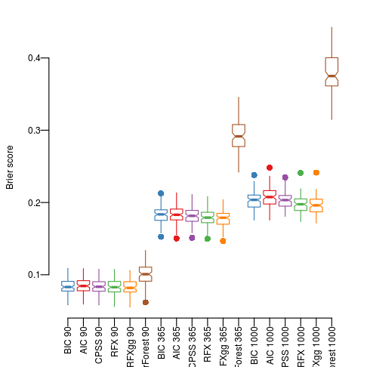
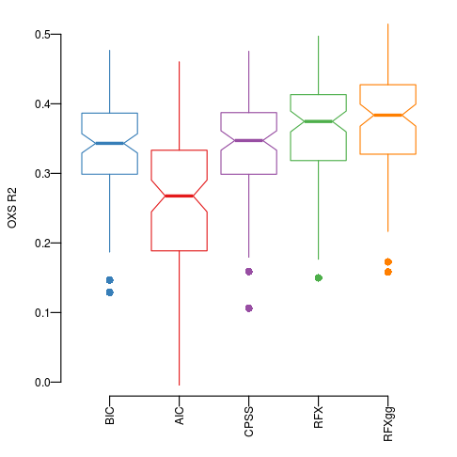
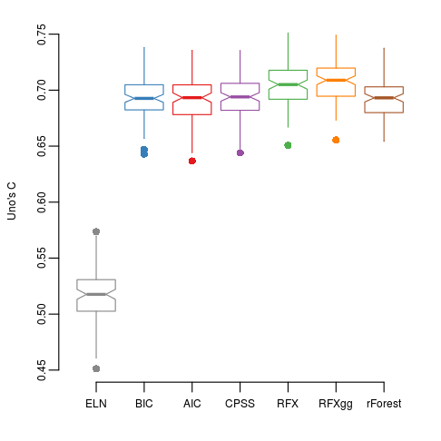
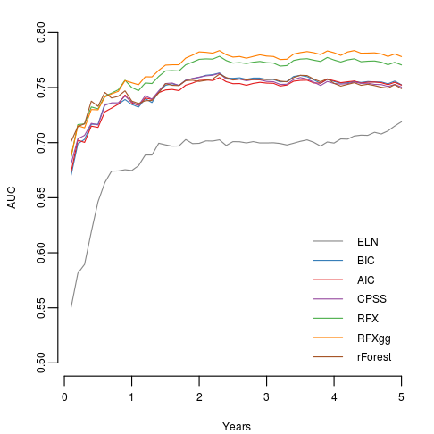
Supplementary Figure 1 Additional metrics for prognostic accuracy

Slide 2
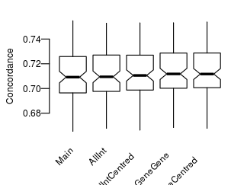
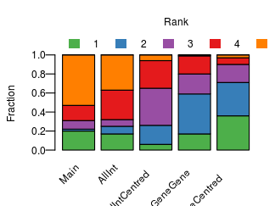
Supplementary Figure 2: Random effects models using different sets of interaction terms

Slide 3
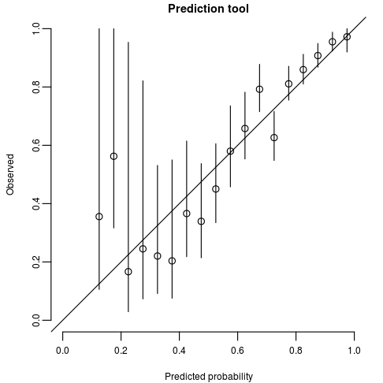
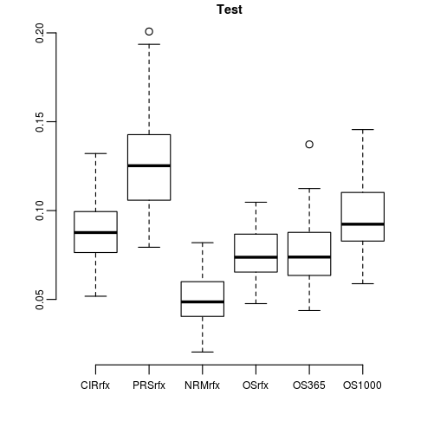
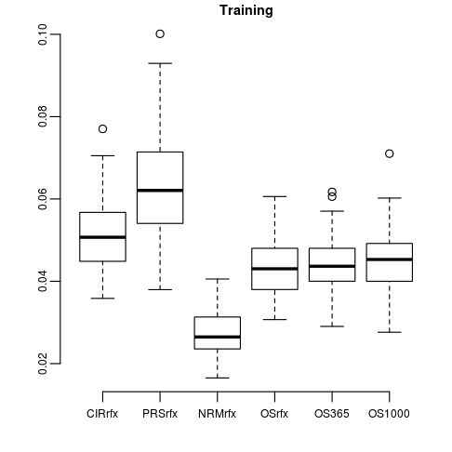
Supplementary Figure 3 Accuracy of absolute risk predictions a. Shows for different risk estimates at 365 days b. Test and training errors; cross-validated

Slide 4
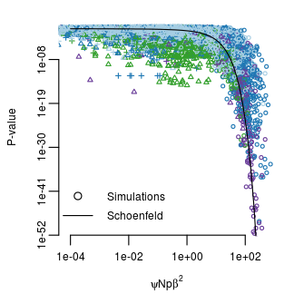
Supplementary Figure 4 Distribution of P-values in simulations of different cohort and effect size.

Slide 5
Supplementary Figure 3

